Slide 1
ShuffleNet V2: Practical Guidelines for Efficient CNN
Architecture Design
Ningning Ma Xiangyu Zhang Hai-Tao Zheng Jian Sun
Megvii Inc (Face++) Tsinghua University
ECCV2018

Slide 2
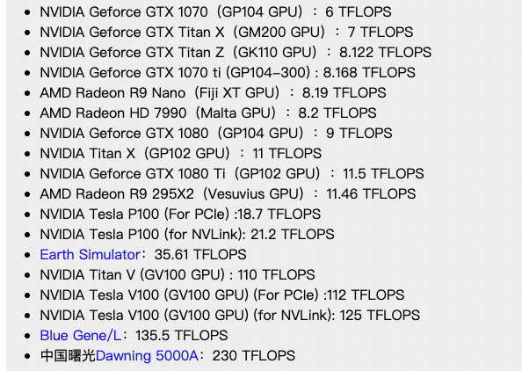
Pre-knowledge
1.FLOPS(floating point of per second)
每秒浮点运算的次数，用来衡量硬件的性能。
和GPU处理器的cuda核心数量以及主频有关。
2.FLOPs(floating point of operations)
浮点运算次数，可以用来衡量算法/模型复杂度

Slide 3
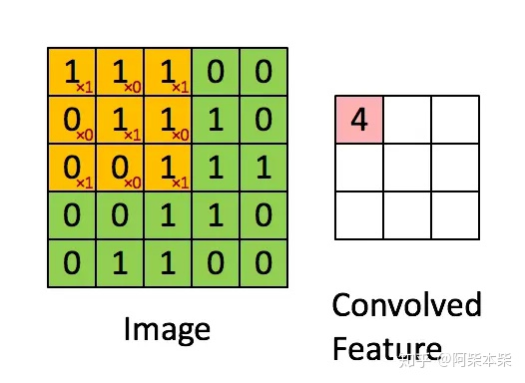
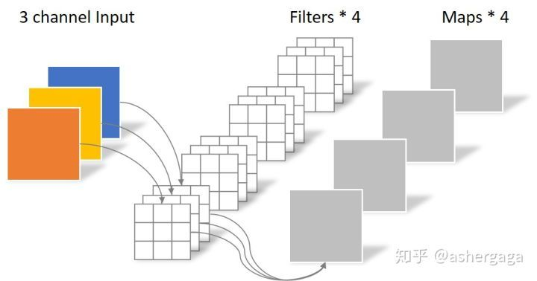
FLOPs计算
k表示卷积核的大小，c表示输入feature map的数量，o表示输出feature map的数量，H和W是输出feature map的高和宽
对于输出feature上的单个unit，有k×k×c次乘法，以及k×k×c - 1次加法
所以卷积层计算总计算量：
乘法次数: k × k × c × H × W × o
加法次数:(k × k × c - 1 + 1) × H × W × o = k × k × c × H × W × o
对于带偏置项的卷积层，乘法运算和加法运算的次数相等，刚好配对。定义一次加法和乘法表示一个flop，该层的计算力消耗为k × k × c × H × W × o。

Slide 4
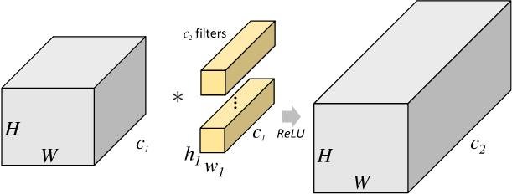

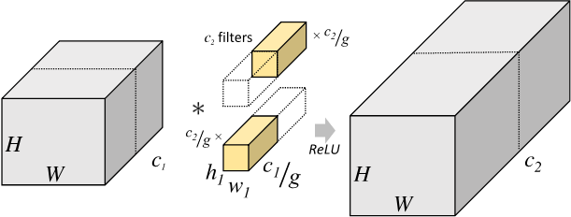
分组卷积(group convolution)
标准卷积的参数数量：
分组卷积的参数数量：

Slide 5
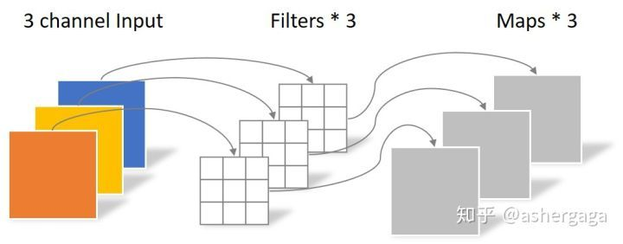
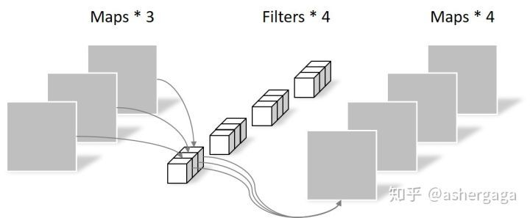
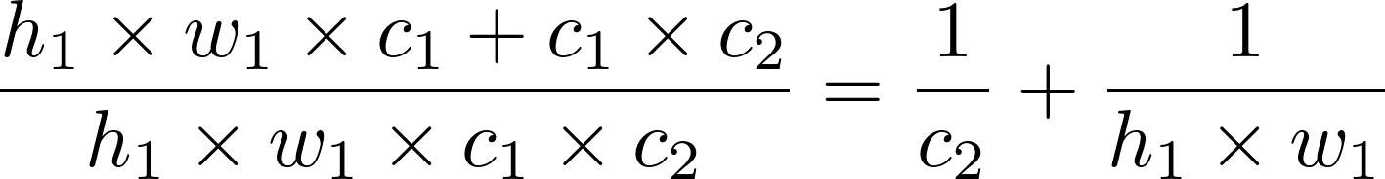
深度可分离卷积(depthwise separable convolution)
1.depthwise convolution
深度可分离卷积的参数数量：
2.pointwise convolution
与标准卷积相比:

Slide 6
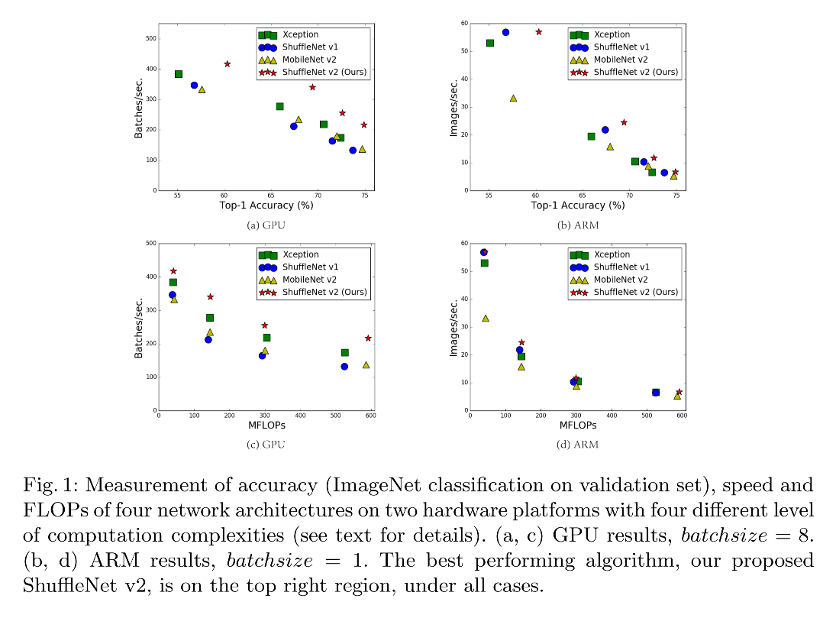
Motivation
To measure the computation complexity, a widely used metric is the number of float-point operations, or FLOPs. However, FLOPs is an indirect metric. It is an approximation of, but usually not equivalent to the direct metric that we really care about, such as speed or latency.
Two reasons：
(1) One such factor is memory access cost (MAC). Such cost constitutes a large portion of runtime in certain operations like group convolution. It could be bottleneck on devices with strong computing power, e.g., GPUs.
(2) Another one is degree of parallelism. A model with high degree of parallelism could be much faster than another one with low degree of parallelism, under the same FLOPs.

Slide 7
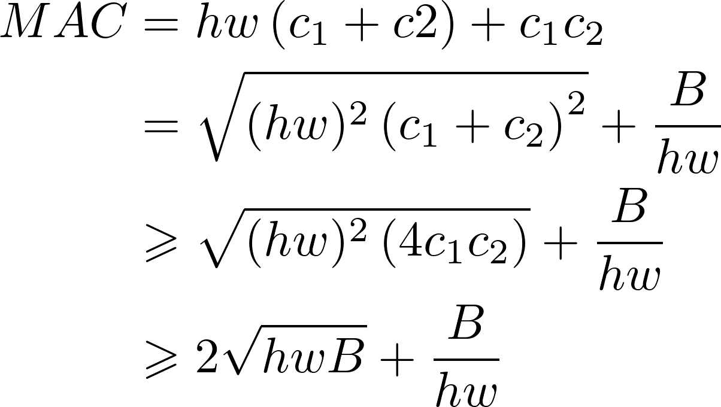
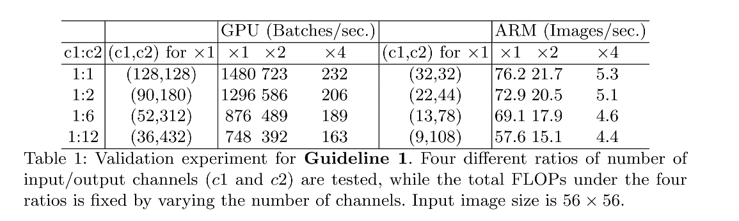
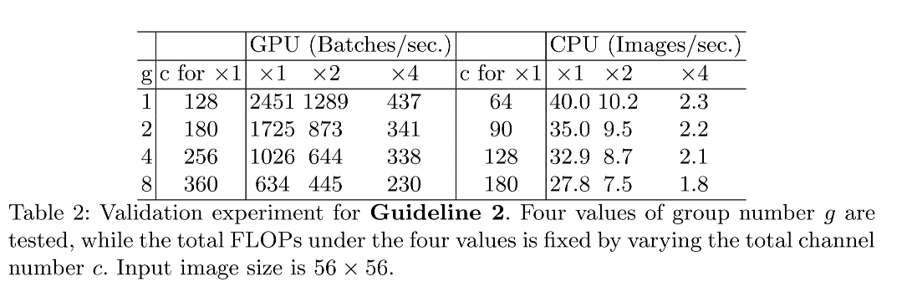
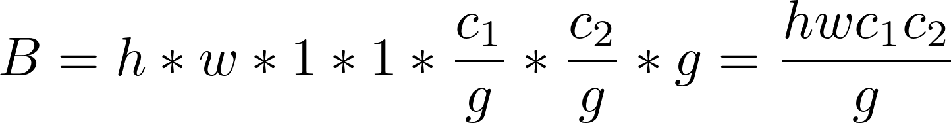
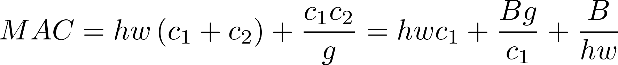
Practical Guidelines for Efficient Network Design
G1) Equal channel width minimizes memory access cost (MAC)
G2) Excessive group convolution increases MAC.

Slide 8
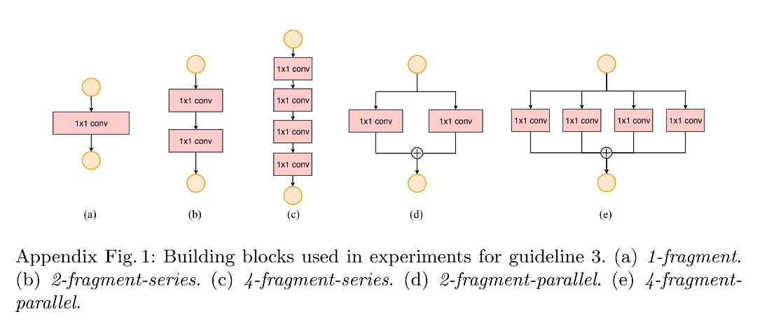
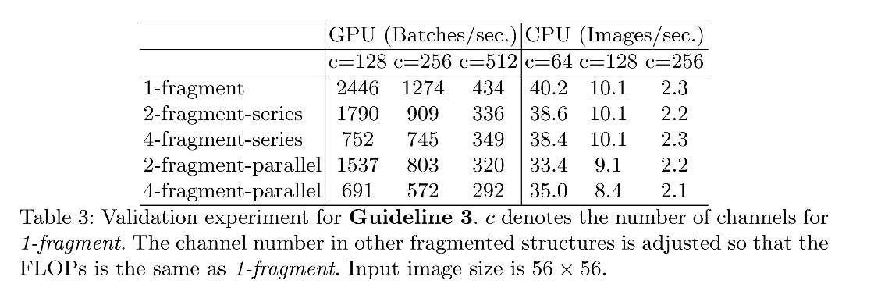
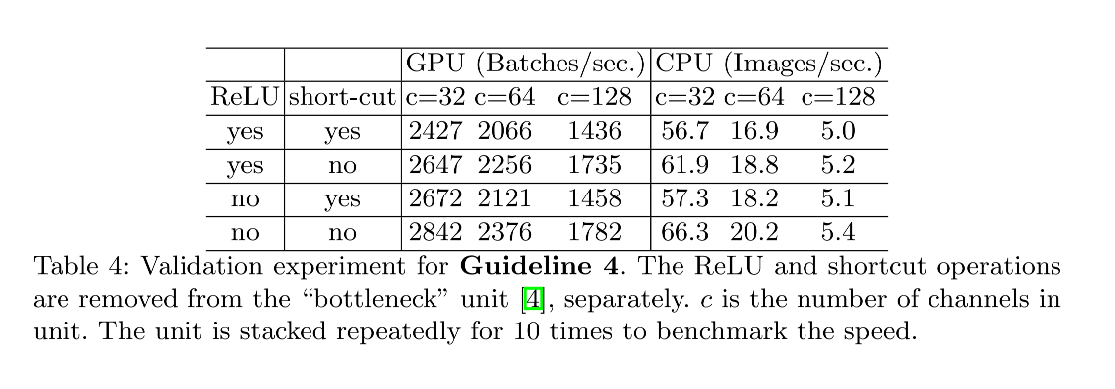
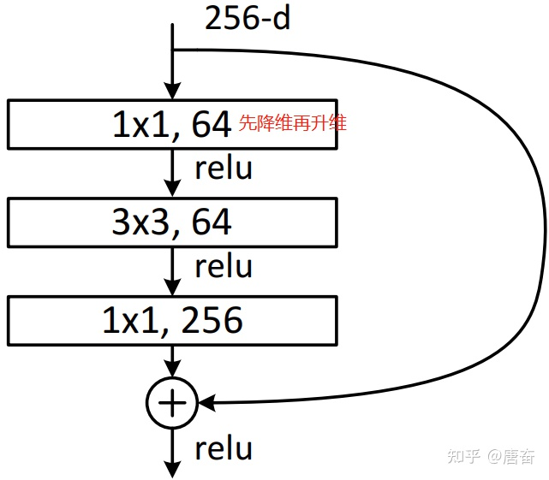
G3) Network fragmentation reduces degree of parallelism.
G4) Element-wise operations are non-negligible.(AddTensor, AddBias, etc)
Use Res-Net bottleneck

Slide 9
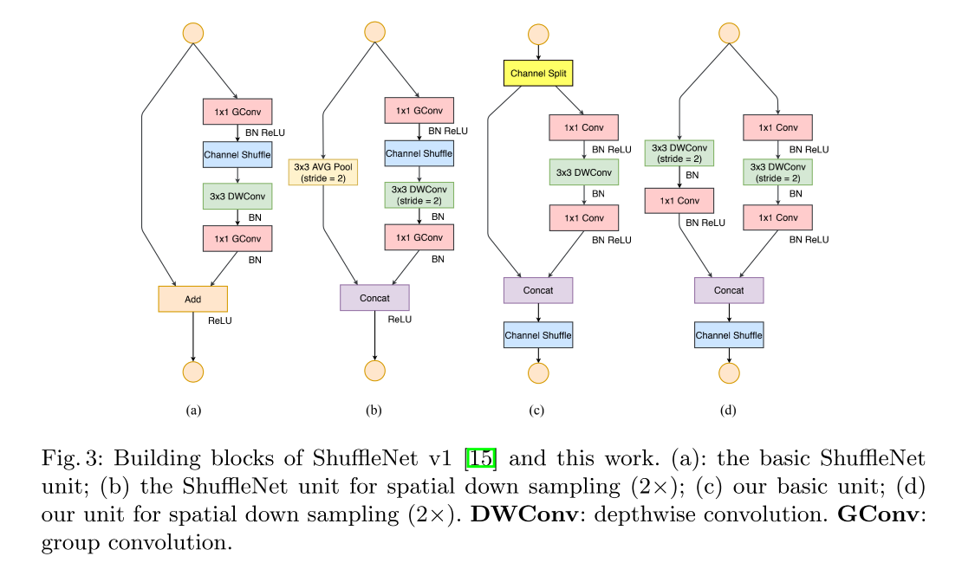
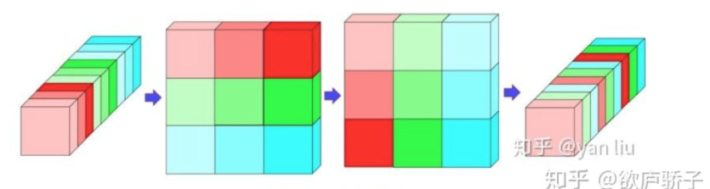
Architecture of Shuffle Net
channel shuffle
Information exchange

Slide 10
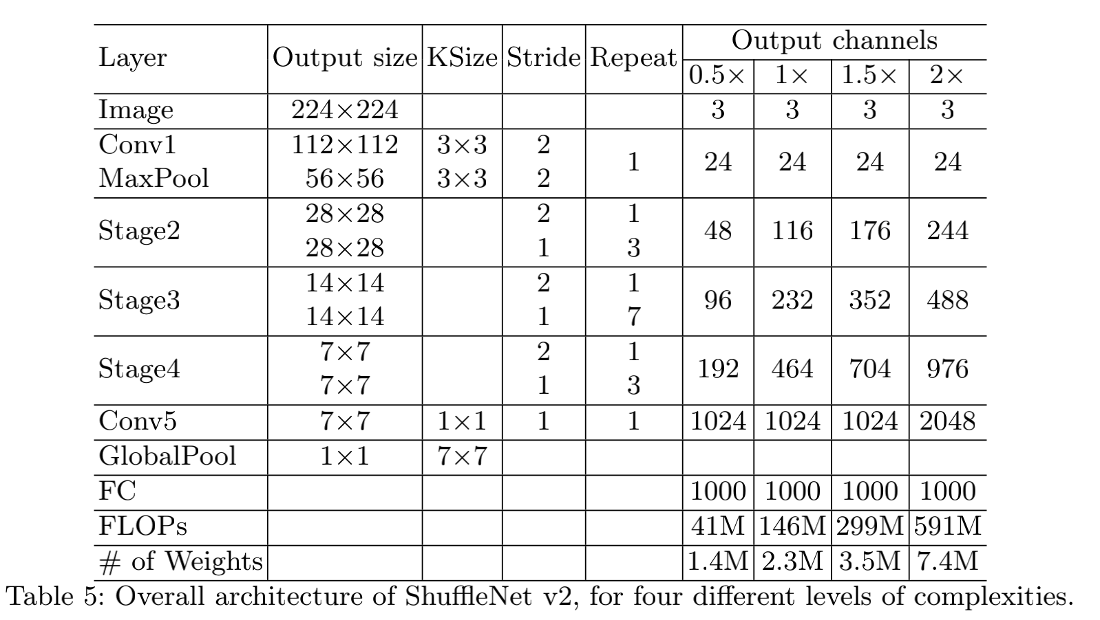

Slide 11
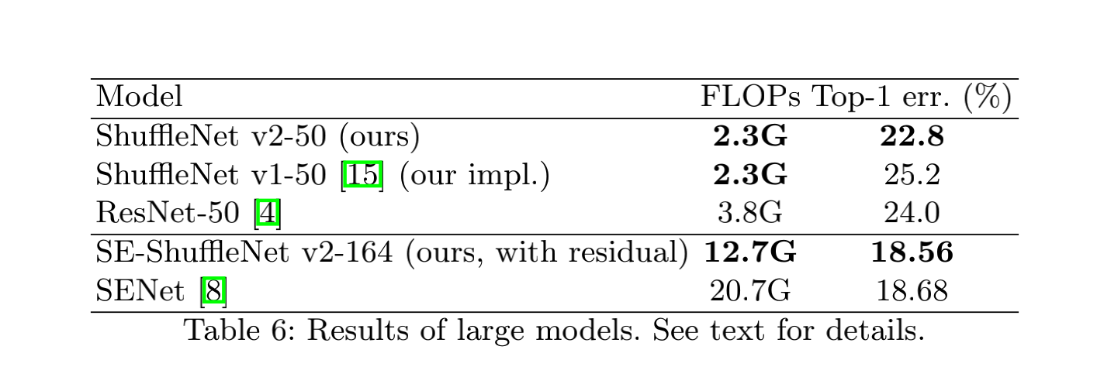
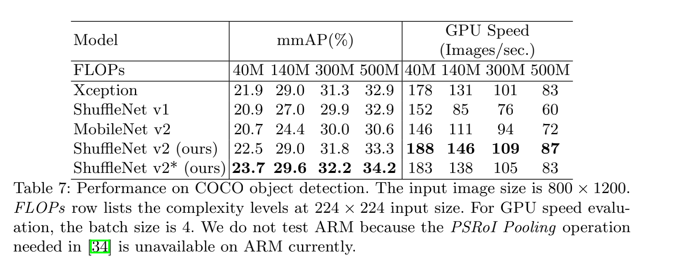
Experiments

Slide 12
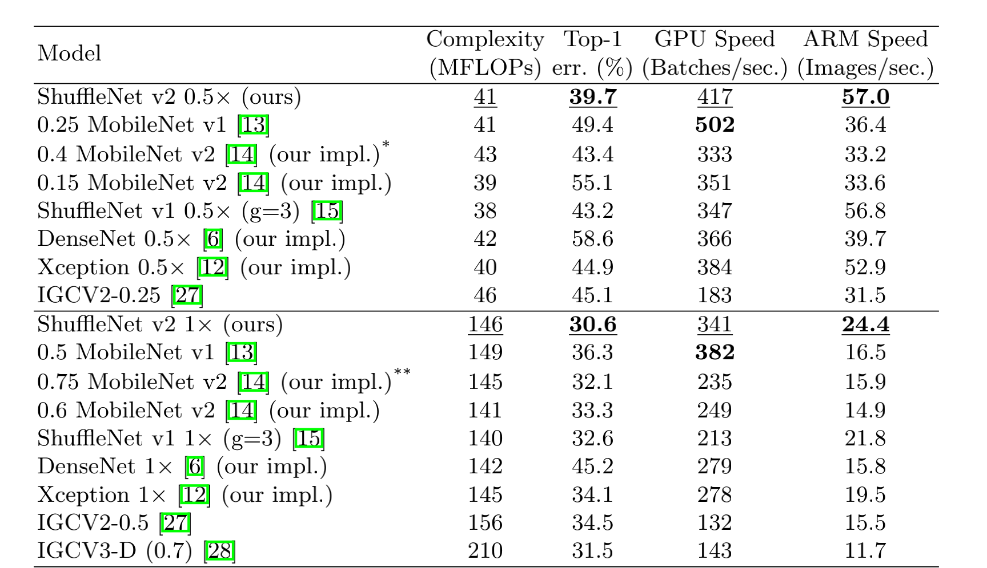

Slide 13
